Slide 1
FP98 SQUIDS and Noise Thermometers
Coc, Q’ inich & Huth, Paris
Experiment perfomed the 21.11.2024
Tutor: Brunold, Axel

Slide 2
Structure
Goals of the experiment
Theoretical Background
Super conductivity
SQUIDs
Noise thermometers
Measuring principles
dc-SQUID Characteristics
FLL mode
Two-stage SQUID Readout
Experiment Setup & Tasks
Evaluation of measurements
Discussion & Comments
Result’s Overview
Discussion
Comments

Slide 3
1. Goals of experiment
Learn the basics of low-temperature physics and superconductivity
Learn the basics of SQUIDs and noise thermometers
Learn how to operate dc-SQUIDs

Slide 4
2. Theoretical background

Slide 5
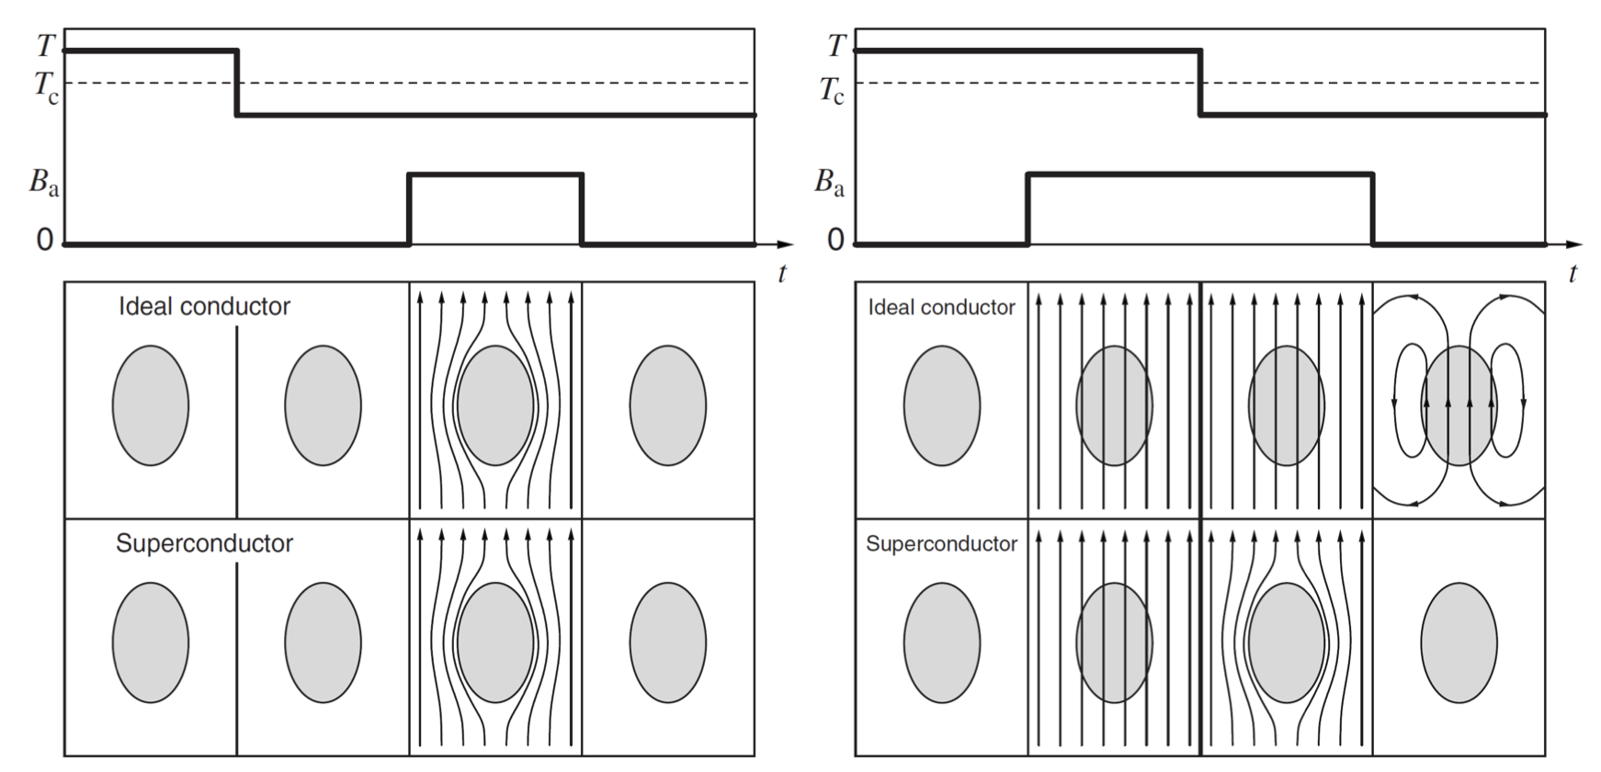
2. Theoretical background
2.1. Superconductivity
Resistance vanishes below a critical temperature T_{C}
When the critical current I_{C} or critical flux density B_{C} is exceeded, enters a normal state.
Not equivalent to an ideal conductor
Expulsion of the magnetic field below critical temperature
Type I
Either in a superconductive or normal state
Perfect Diamagnets up to critical Field H_{C}
Type II
Additional mixed-state producing magnetic field vortexes
Fig. 1: Meißner Ochsenfeld effect
Notes:
superconducting coherence length ξ in addition to London magnetic field penetration depth λ. According to Ginzburg–Landau theory, in a type-II superconductor λ/ξ>1/2.
Each vortex obeys London's magnetic flux quantization and carries one quantum of magnetic flux Φ0.
Magnetic flux density B
Magnetic Field H

Slide 6
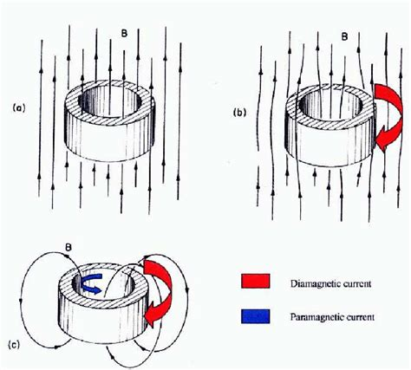
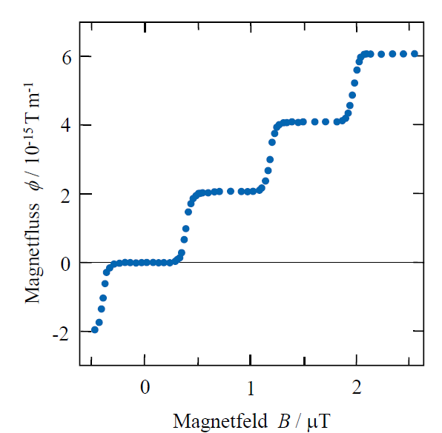
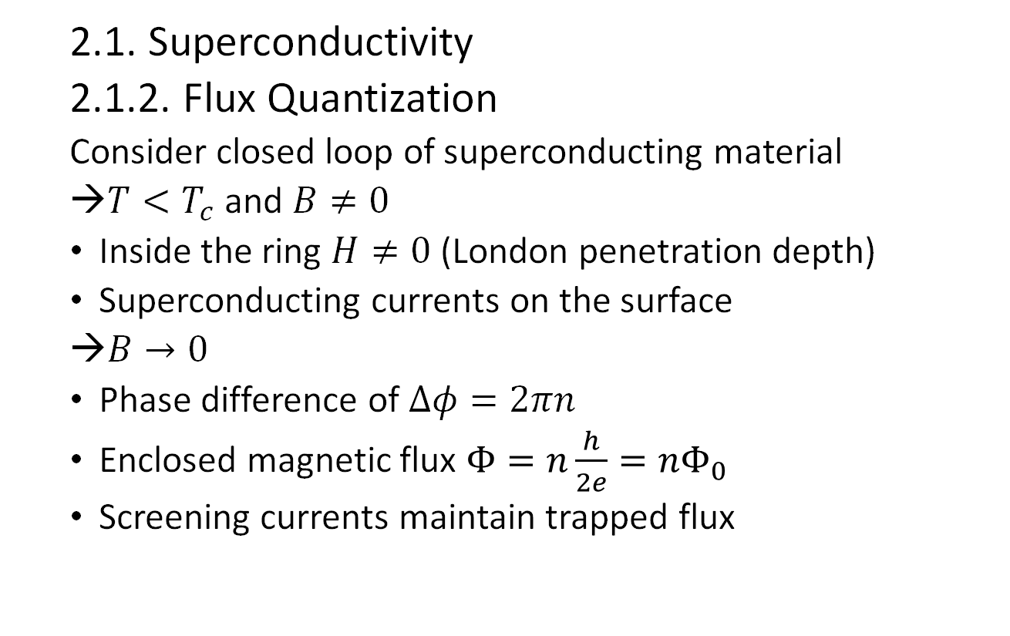
2. Theoretical background
2.1. Superconductivity
2.1.2. Flux Quantization
Consider closed loop of superconducting material
$T<T_{c}$ and $B≠0$
Inside the ring $H≠0$ (London penetration depth)
Superconducting currents on the surface
$B→0$
Phase difference of $Δφ=2πn$
Enclosed magnetic flux $Φ=n\frac{h}{2e}=nΦ_{0}$
Screening currents maintain trapped flux
Notes:
B field, magnetic flux density going through the ring (top picture)
H penetrates into volume -> magnetization. Supercurrents on the surface which don’t decay in time. B-> 0, the B-field inside the loop gets trapped.

Slide 7
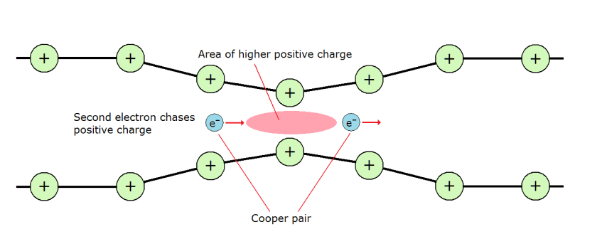
2. Theoretical background
2.1. Superconductivity
2.1.1. Cooper-pairs (CPs)
Attractive interaction between electrons due to interaction with atom lattice
CP described by a two-particle wave function
CP behave like bosons
→ CPs condensate, i.e. common macroscopic ground-state wave-function
Notes:
Spins of two electrons couple to the singlet state S=0 Flux quantization and Josephon-effect are caused by the common macroscopic wave-funciton

Slide 8
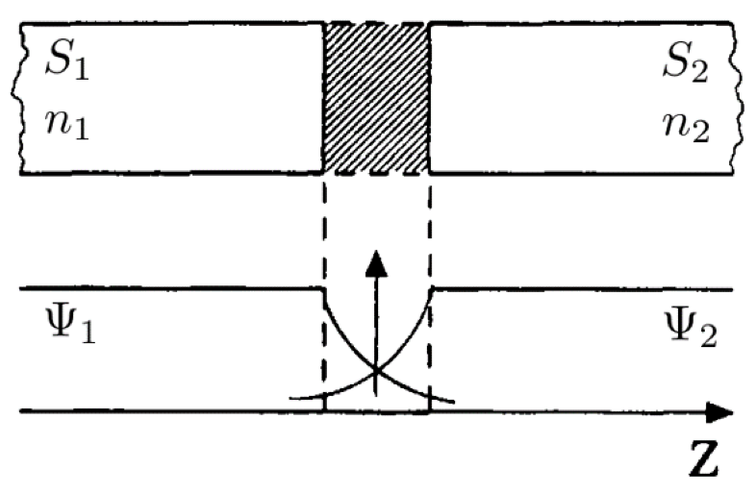
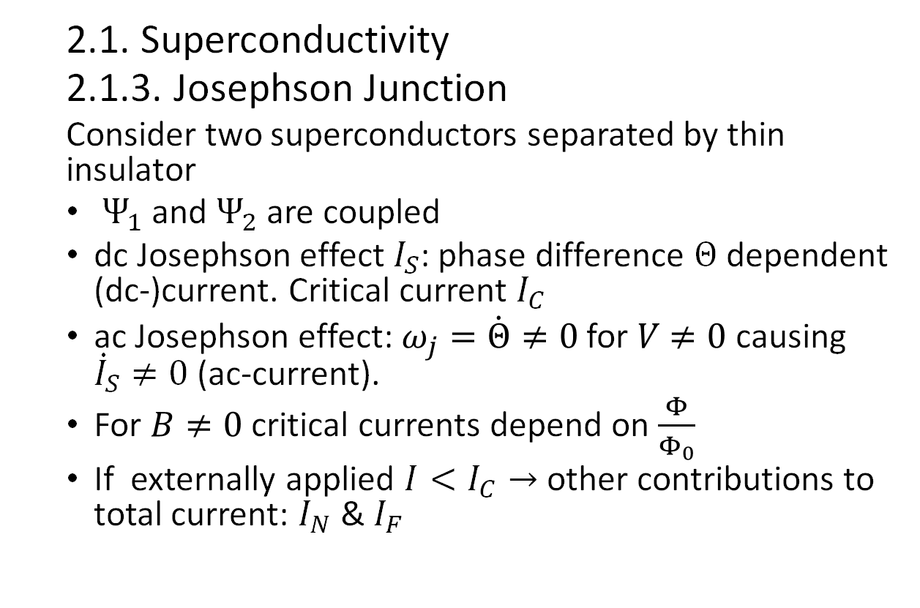
2. Theoretical background
2.1. Superconductivity
2.1.3. Josephson Junction
Consider two superconductors separated by thin insulator
$Ψ_{1}$ and $Ψ_{2}$ are coupled
dc Josephson effect $I_{S}$: phase difference $Θ$ dependent (dc-)current. Critical current $I_{C}$
ac Josephson effect: $ω_{j}=\dot{Θ}≠0$ for $V$ $≠0$ causing ${\dot{I}}_{S}≠0$ (ac-current).
For $B≠0$ critical currents depend on $\frac{Φ}{Φ_{0}}$
If externally applied $I<I_{C}→$ other contributions to total current: $I_{N}$& $I_{F}$
Notes:
n_i = density of cooper pairs if both S_i are from same material n_1 = n_2
Chemical potential equal for zero V, kappa coupling constant
Phase of CPs
Omega_j = josephson frequency
Supercurrent I_S: Flowing without a voltage with dc JE | Zero voltage state
ac JE | Voltage state

Slide 9
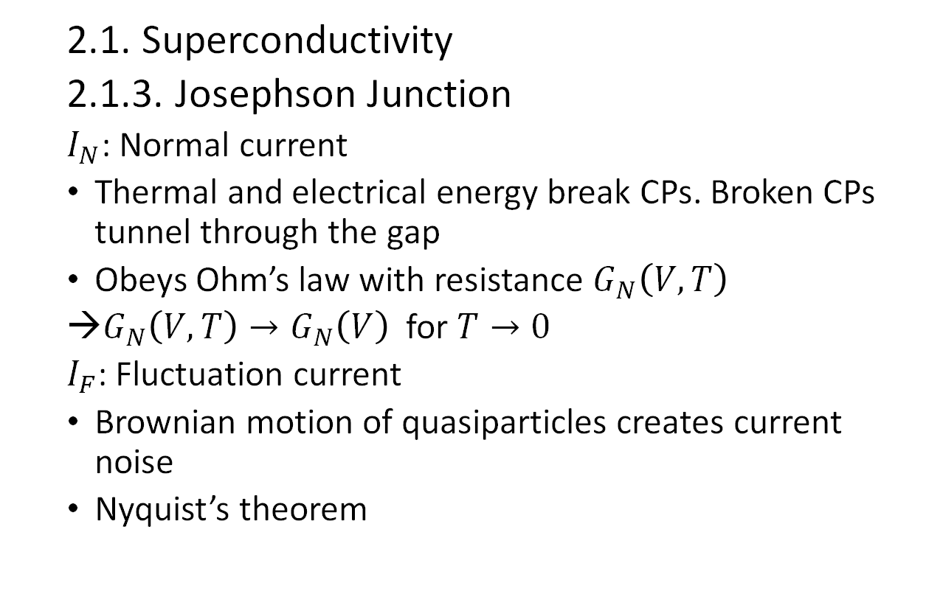
2. Theoretical background
2.1. Superconductivity
2.1.3. Josephson Junction
$I_{N}$: Normal current
Thermal and electrical energy break CPs. Broken CPs tunnel through the gap
Obeys Ohm’s law with resistance $G_{N}\left(V,T\right)$
$G_{N}\left(V,T\right)→G_{N}\left(V\right)$for $T→0$
$I_{F}$: Fluctuation current
Brownian motion of quasiparticles creates current noise
Nyquist’s theorem
Notes:
For T>0 thermal energy breaks CPs
I> I_C aka V = I*R> V_g electric. Breaks CPs

Slide 10
3. Measuring principles

Slide 11
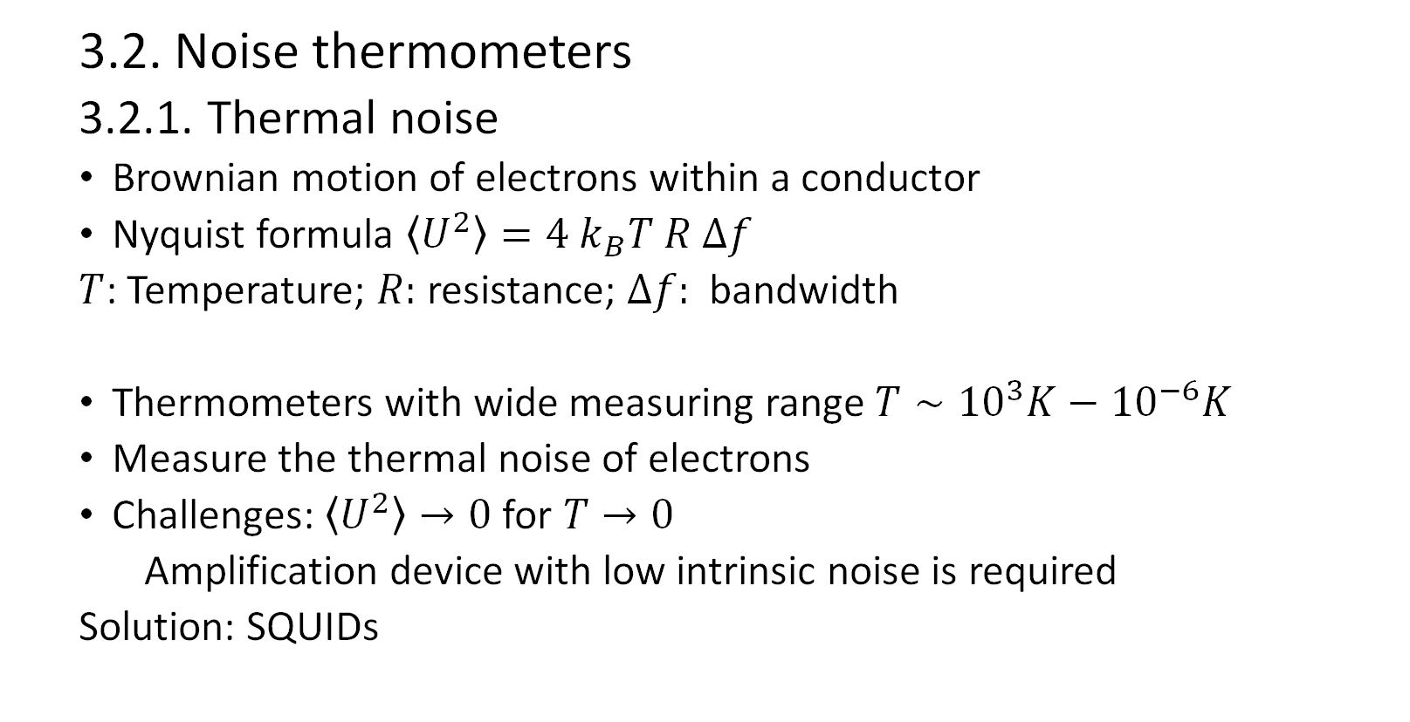
3. Measuring principles
3. Measuring principles
3.2. Noise thermometers
3.2.1. Thermal noise
Brownian motion of electrons within a conductor
Nyquist formula $\left\langle U^{2}\right\rangle =4 k_{B}T R Δf$
$T$: Temperature; $R:$ resistance; $Δf:$ bandwidth
Thermometers with wide measuring range $T∼{10}^{3}K−{10}^{−6}K$
Measure the thermal noise of electrons
Challenges: $\left\langle U^{2}\right\rangle →0$ for $T→0$
Amplification device with low intrinsic noise is required
Solution: SQUIDs
Notes:
Brownian motion: random movement of particles in a liquid medium due to thermal movement of medium and particles
Proportion between varian and T,R, \Delta f found, Nyquist identified it as thermal motion

Slide 12
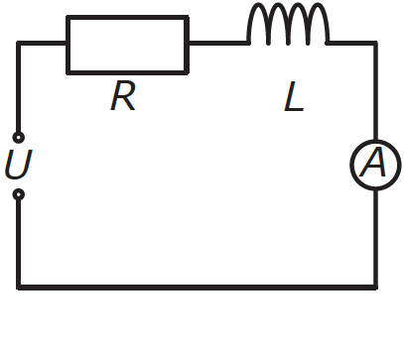
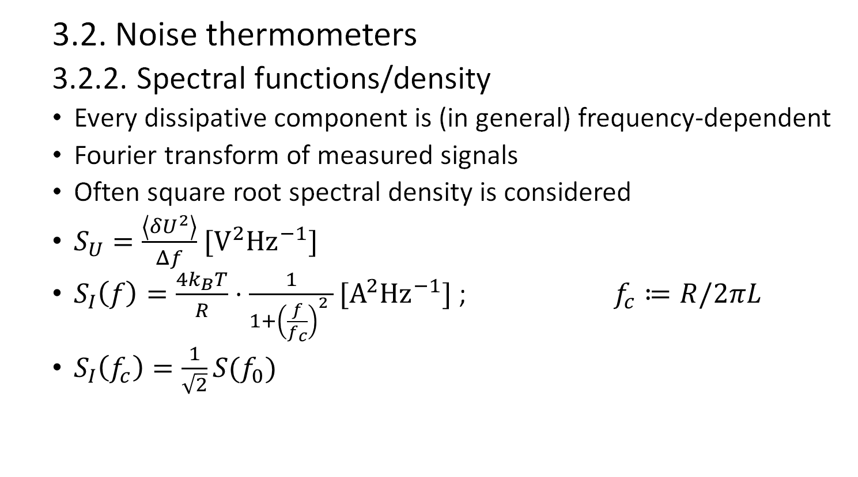
3. Measuring principles
3. Measuring principles
3.2. Noise thermometers
3.2.2. Spectral functions/density
Every dissipative component is (in general) frequency-dependent
Fourier transform of measured signals
Often square root spectral density is considered
$S_{U}=\frac{\left\langle {δU}^{2}\right\rangle }{Δf}$ $[V^{2}{Hz}^{−1}]$
$S_{I}\left(f\right)=\frac{4k_{B}T}{R}⋅\frac{1}{1+{\left(\frac{f}{f_{c}}\right)}^{2} }[A^{2}{Hz}^{−1}]$ ; $f_{c}≔R/2πL$
$S_{I}\left(f_{c}\right)=\frac{1}{\sqrt{2}}S(f_{0})$
Notes:
<A^2> = \int_f_0^f_0+\Deltaf insert niquist formula and derivate i.r f
S_I user kirschhoff’s low

Slide 13
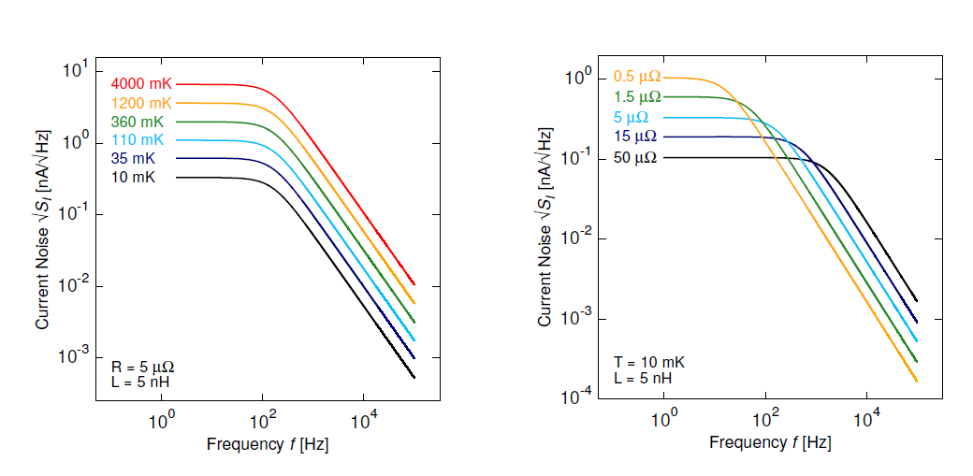
3. Measuring principles
3.2. Noise thermometers
3.2.2. Spectral functions/density
Notes:
<A^2> = \int_f_0^f_0+\Deltaf insert niquist formula and derivate i.r f
S_I user kirschhoff’s low

Slide 14
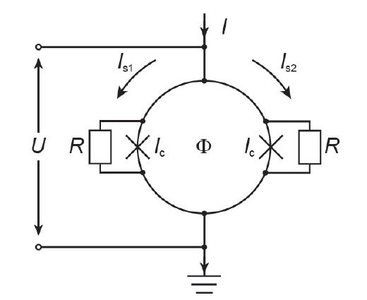
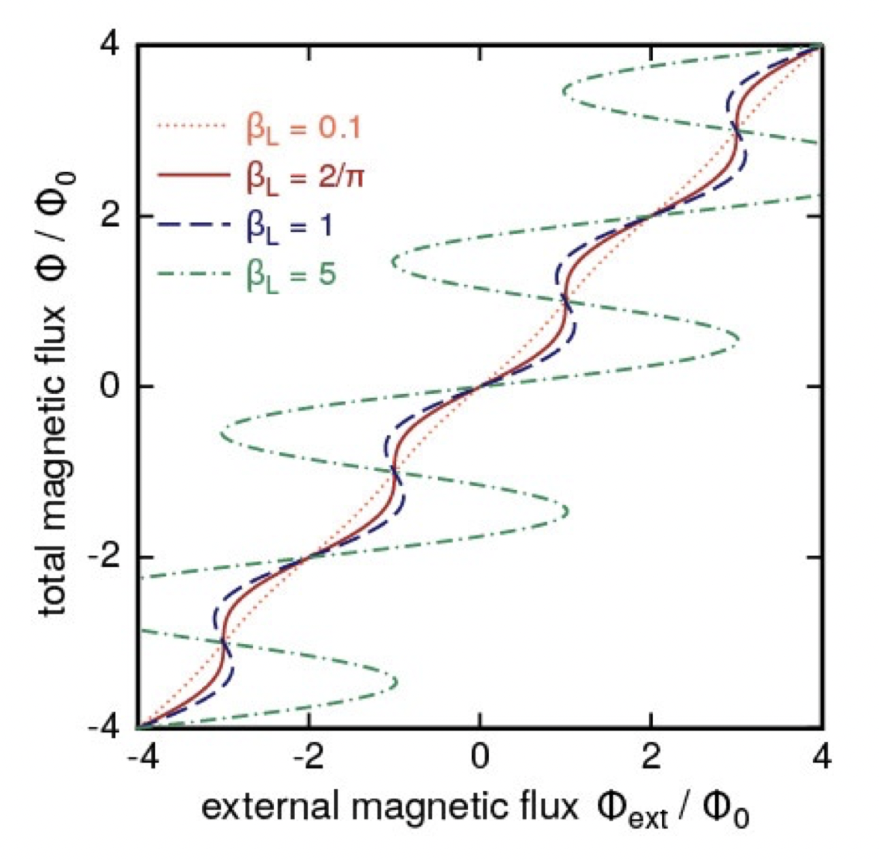
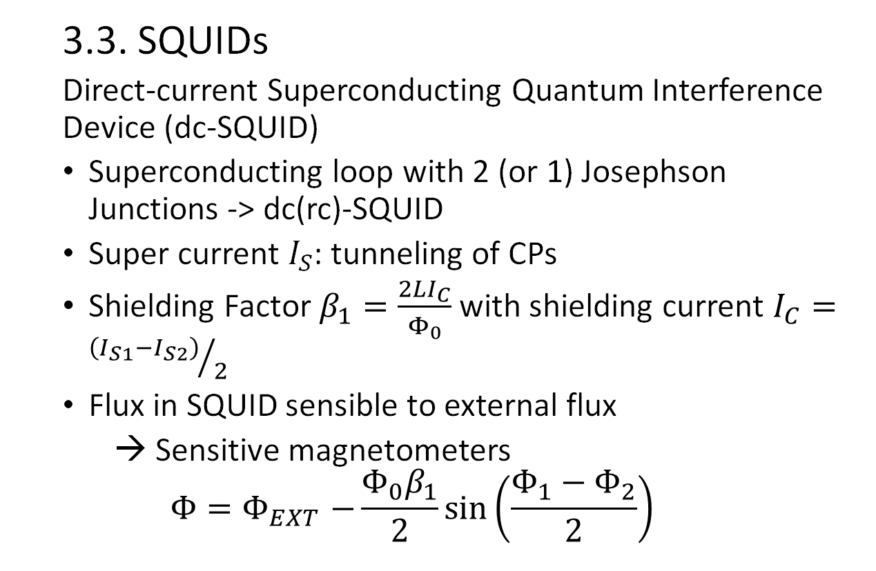
3. Measuring principles
3.3. SQUIDs
Direct-current Superconducting Quantum Interference Device (dc-SQUID)
Superconducting loop with 2 (or 1) Josephson Junctions -> dc(rc)-SQUID
Super current $I_{S}$: tunneling of CPs
Shielding Factor $β_{1}=\frac{2LI_{C}}{Φ_{0}}$ with shielding current $I_{C}={\left(I_{S1}−I_{S2}\right)}/2$
Flux in SQUID sensible to external flux
→ Sensitive magnetometers
$$Φ{=Φ}_{EXT}−\frac{Φ_{0}β_{1}}{2}\sin\left(\frac{Φ_{1}−Φ_{2}}{2}\right)$$

Slide 15
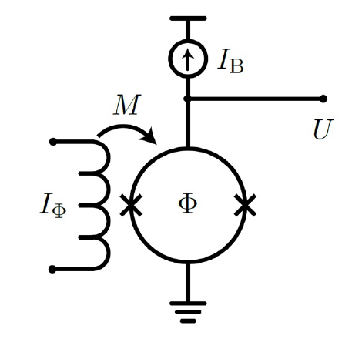
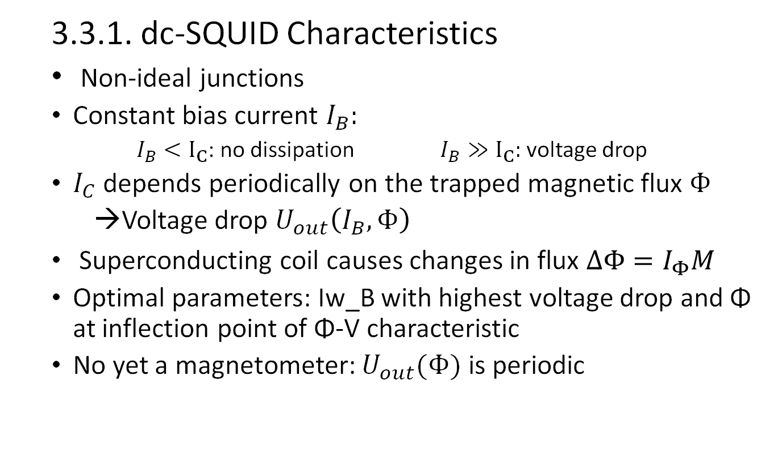
3. Measuring principles
3.3.1. dc-SQUID Characteristics
Non-ideal junctions
Constant bias current $I_{B}:$
$I_{B}<I_{C}$: no dissipation $I_{B}≫I_{C}:$ voltage drop
$I_{C}$ depends periodically on the trapped magnetic flux $Φ$
Voltage drop $U_{out}\left(I_{B}, Φ\right)$
Superconducting coil causes changes in flux $ΔΦ=I_{Φ}M$
Optimal parameters: Iw_B with highest voltage drop and Φ at inflection point of Φ-V characteristic
No yet a magnetometer: $U_{out}(Φ)$ is periodic
Notes:
Coil couples to super conducting ring
I_\Phi current through coil , M: mutual inductance

Slide 16
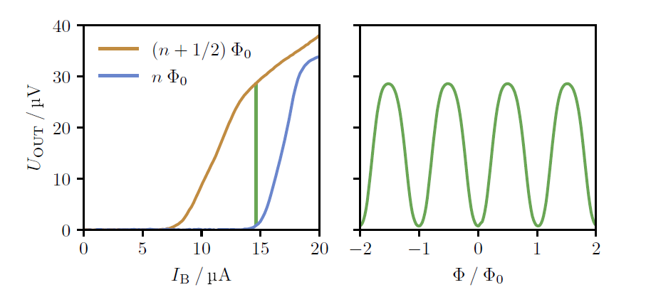
3. Measuring principles
3.3.1. dc-SQUID Characteristics
Notes:
<A^2> = \int_f_0^f_0+\Deltaf insert niquist formula and derivate i.r f
S_I user kirschhoff’s low

Slide 17
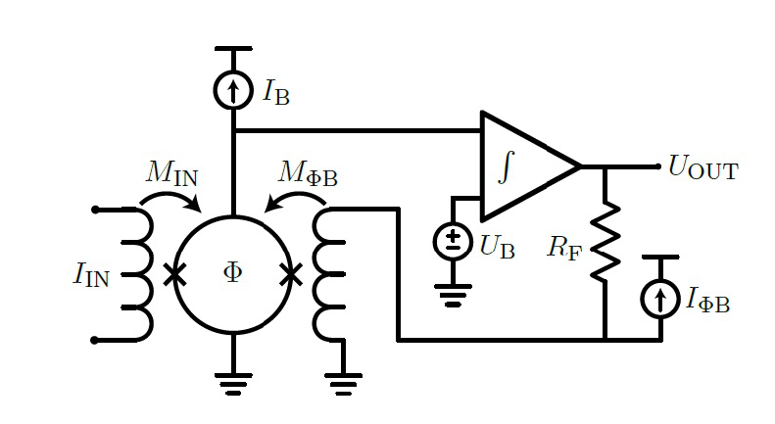
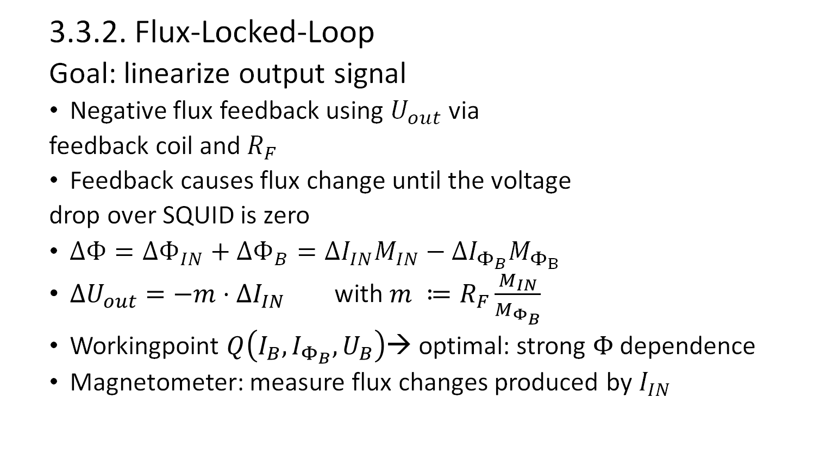
3. Measuring principles
3.3.2. Flux-Locked-Loop
Goal: linearize output signal
Negative flux feedback using $U_{out}$ via
feedback coil and $R_{F}$
Feedback causes flux change until the voltage
drop over SQUID is zero
$ΔΦ=ΔΦ_{IN}+ΔΦ_{B}=ΔI_{IN}M_{IN}−ΔI_{Φ_{B}}M_{Φ_{B}}$
$ΔU_{out}=−m⋅ΔI_{IN}$ with $m ≔R_{F}\frac{M_{IN}}{M_{Φ_{B}}}$
Workingpoint $Q\left(I_{B}, I_{Φ_{B}}, U_{B}\right)$→ optimal: strong $Φ$ dependence
Magnetometer: measure flux changes produced by $I_{IN}$
Notes:
Workingpoint, set of parameters in which the system is stable: remains the same for different perturbations, aka. Input signals

Slide 18
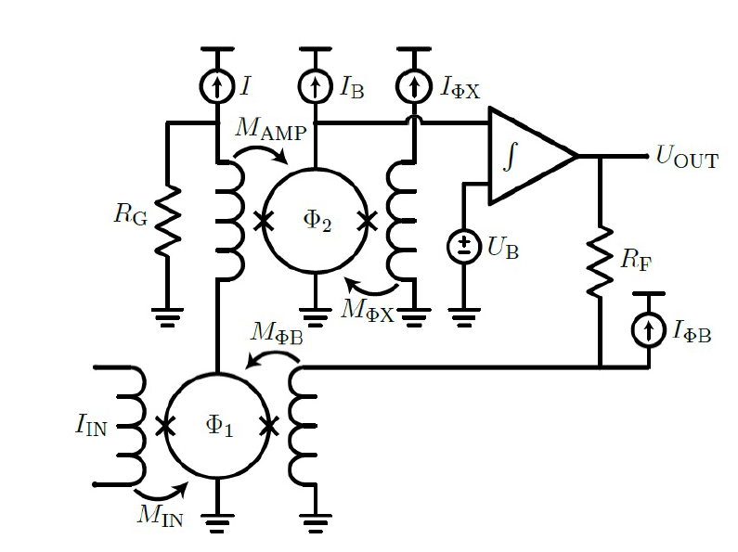
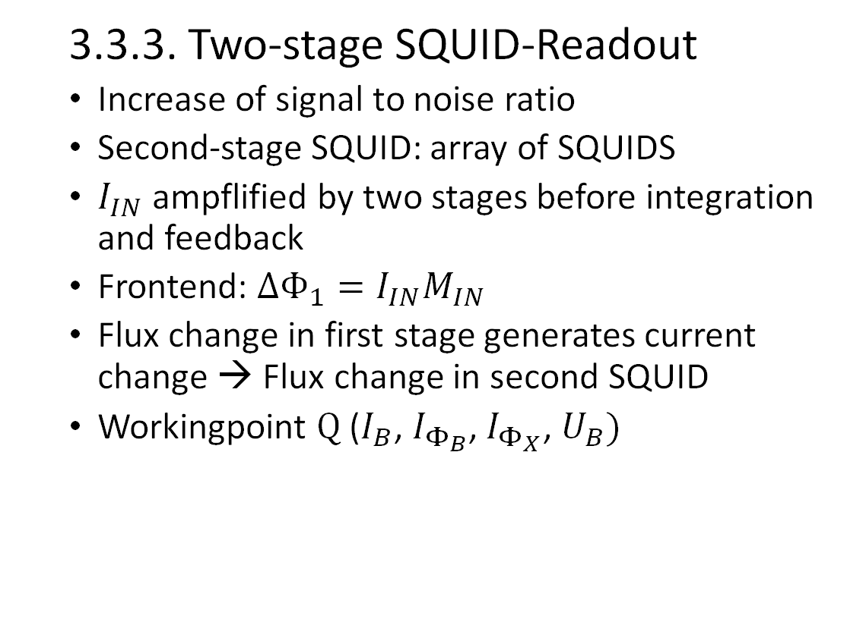
3. Measuring principles
3.3.3. Two-stage SQUID-Readout
Increase of signal to noise ratio
Second-stage SQUID: array of SQUIDS
$I_{IN}$ ampflified by two stages before integration and feedback
Frontend: $ΔΦ_{1}=I_{IN}M_{IN}$
Flux change in first stage generates current change → Flux change in second SQUID
Workingpoint $Q$($I_{B}$, $I_{Φ_{B}}$, $I_{Φ_{X}}$, $U_{B})$
Notes:
Figure: two-stage FLL SQUID
Flux change in the first SQUID generates flux change in \Delata\Phi_2 input coil

Slide 19
4. Experiment setup & tasks

Slide 20
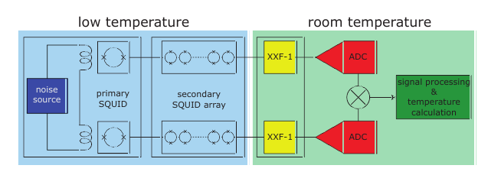
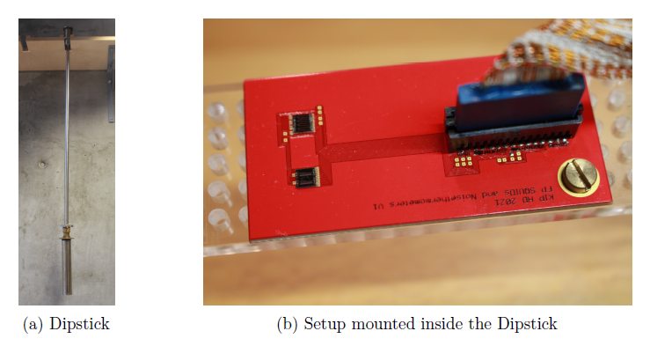
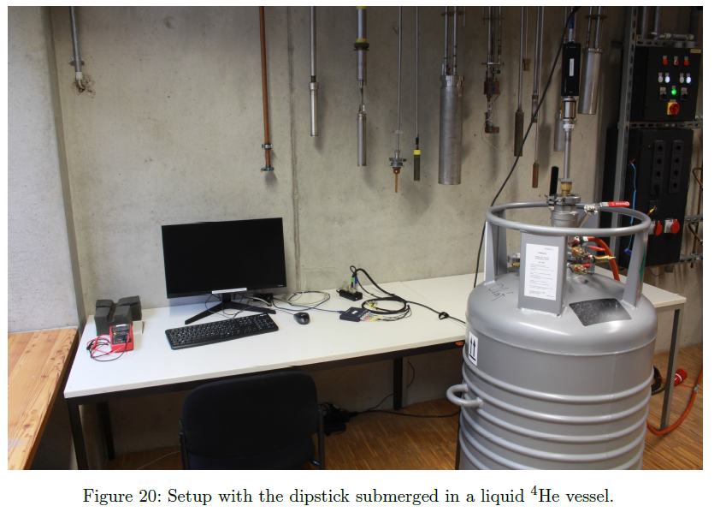
4. Experiment setup & tasks
4.1. Set up

Slide 21
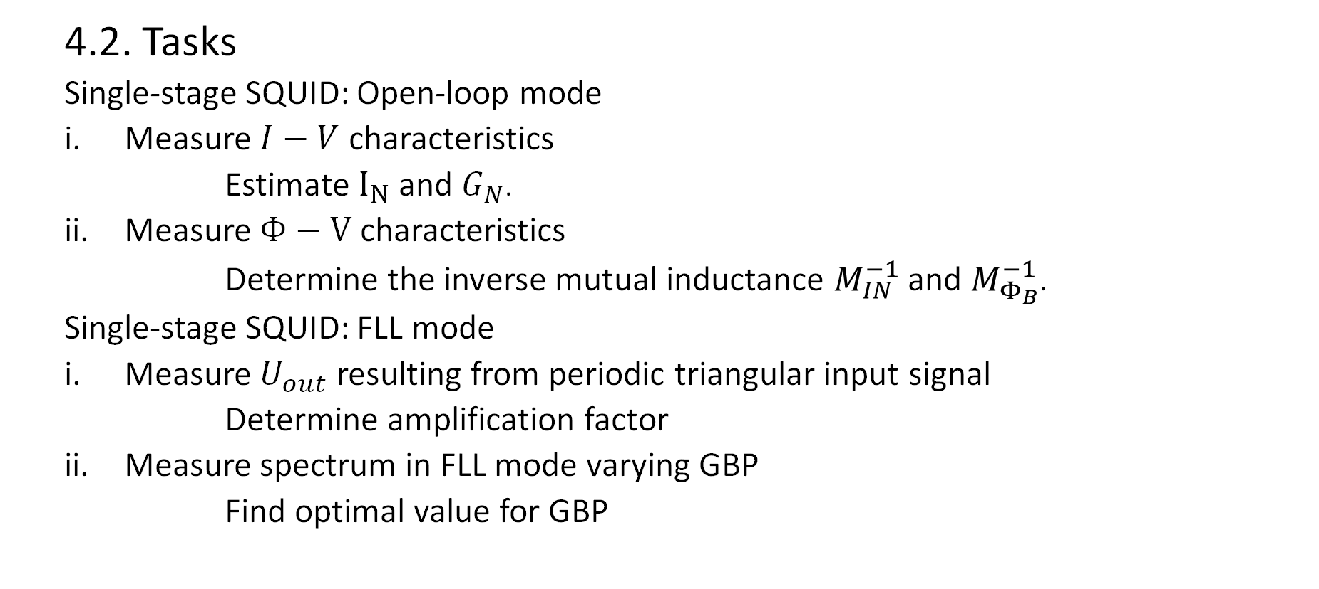
4. Experiment setup & tasks
4.2. Tasks
Single-stage SQUID: Open-loop mode
Measure $I−V$ characteristics
Estimate $I_{N}$ and $G_{N}$.
Measure $Φ−V$ characteristics
Determine the inverse mutual inductance $M_{IN}^{−1}$ and $M_{Φ_{B}}^{−1}$.
Single-stage SQUID: FLL mode
Measure $U_{out}$ resulting from periodic triangular input signal
Determine amplification factor
Measure spectrum in FLL mode varying GBP
Find optimal value for GBP

Slide 22
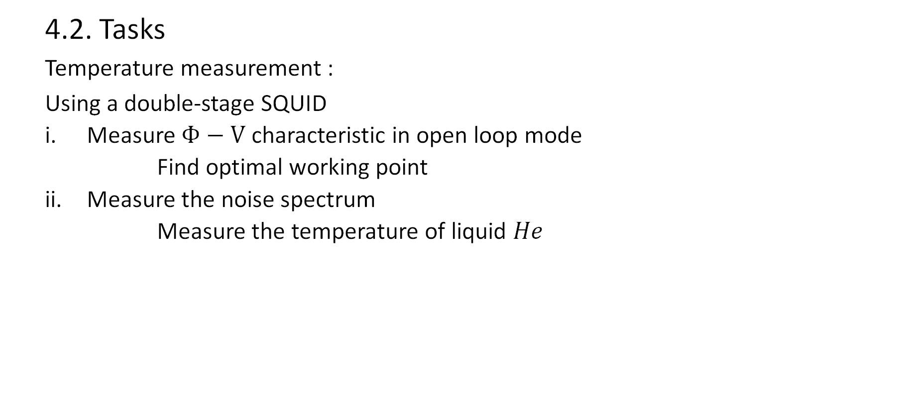
4. Experiment setup & tasks
4.2. Tasks
Temperature measurement :
Using a double-stage SQUID
Measure $Φ−V$ characteristic in open loop mode
Find optimal working point
Measure the noise spectrum
Measure the temperature of liquid $He$

Slide 23
5. Evaluation of measurements

Slide 24
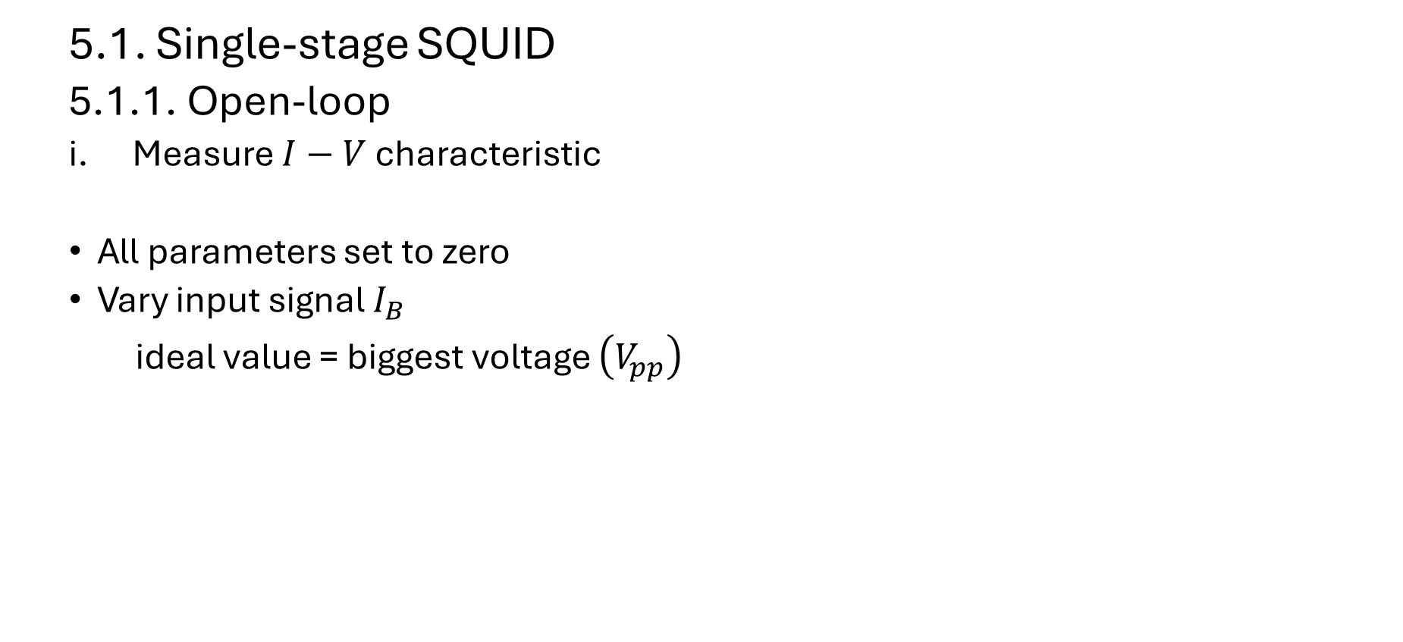
5. Evaluation of measurements
5.1. Single-stage SQUID
5.1.1. Open-loop
Measure $I−V$ characteristic
All parameters set to zero
Vary input signal $I_{B}$
ideal value = biggest voltage $\left(V_{pp}\right)$
input-signal
Notes:
Set everyting to zero. Only turn on biasing current. AMP mode (open loop) U_out amplified by 2000

Slide 25
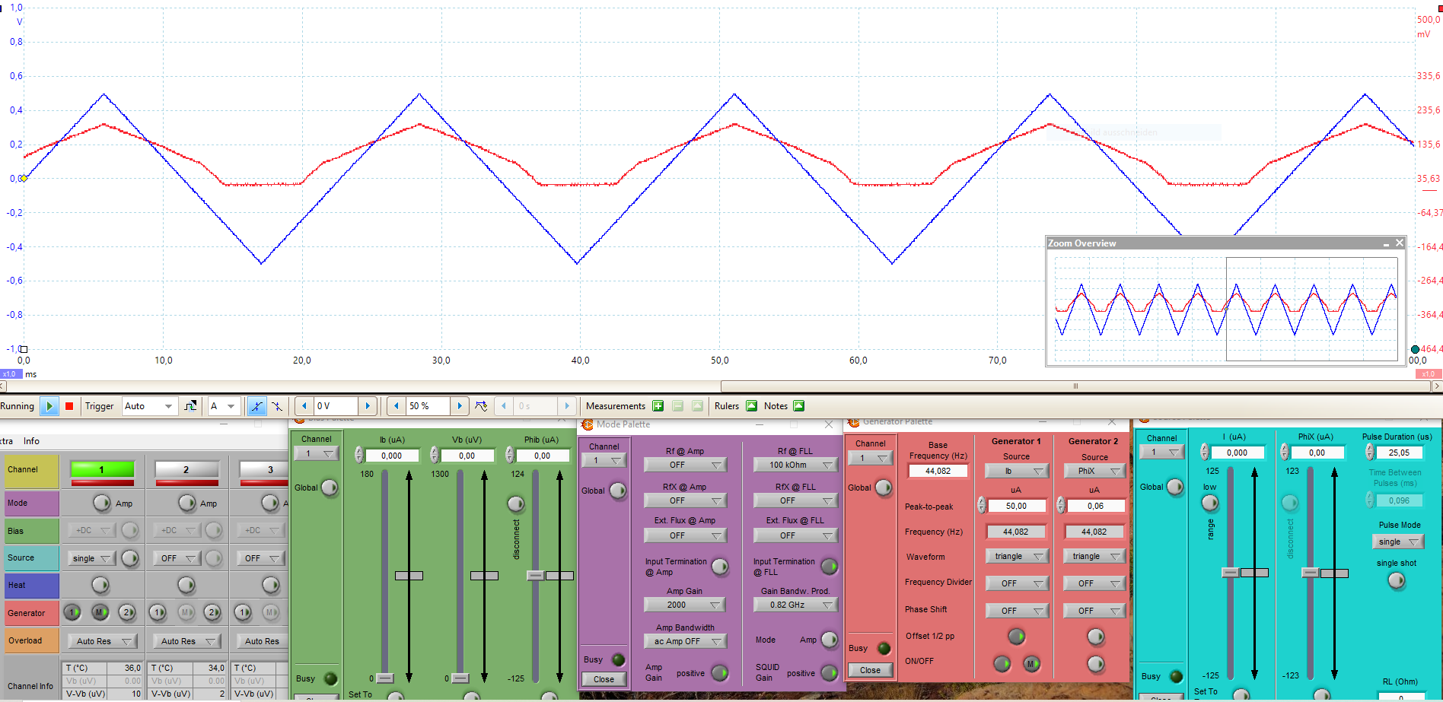
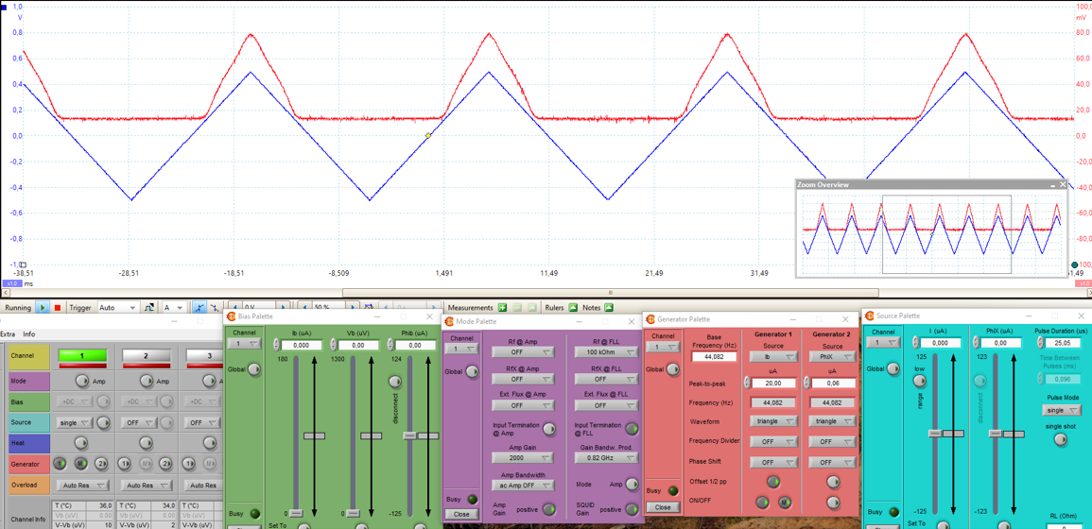
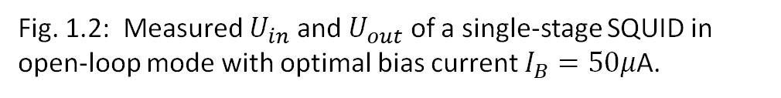
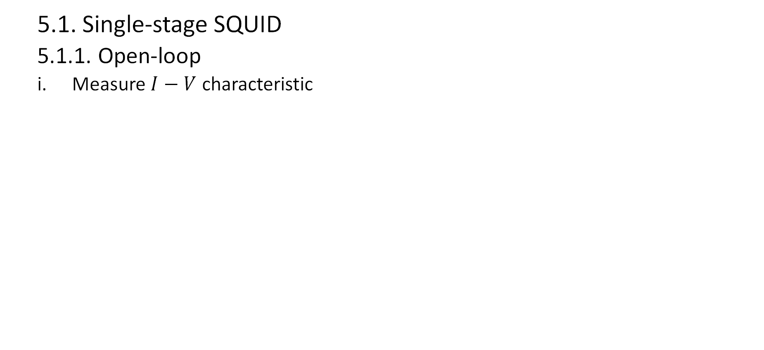
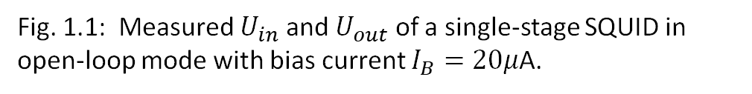
5. Evaluation of measurements
5.1. Single-stage SQUID
5.1.1. Open-loop
Measure $I−V$ characteristic
Fig. 1.2: Measured $U_{in}$ and $U_{out}$ of a single-stage SQUID in open-loop mode with optimal bias current $I_{B}=50μ$A.
Fig. 1.1: Measured $U_{in}$ and $U_{out}$ of a single-stage SQUID in open-loop mode with bias current $I_{B}=20μ$A.
Notes:
Set everyting to zero. Only turn on biasing current. AMP mode (open loop) U_out amplified by 2000

Slide 26
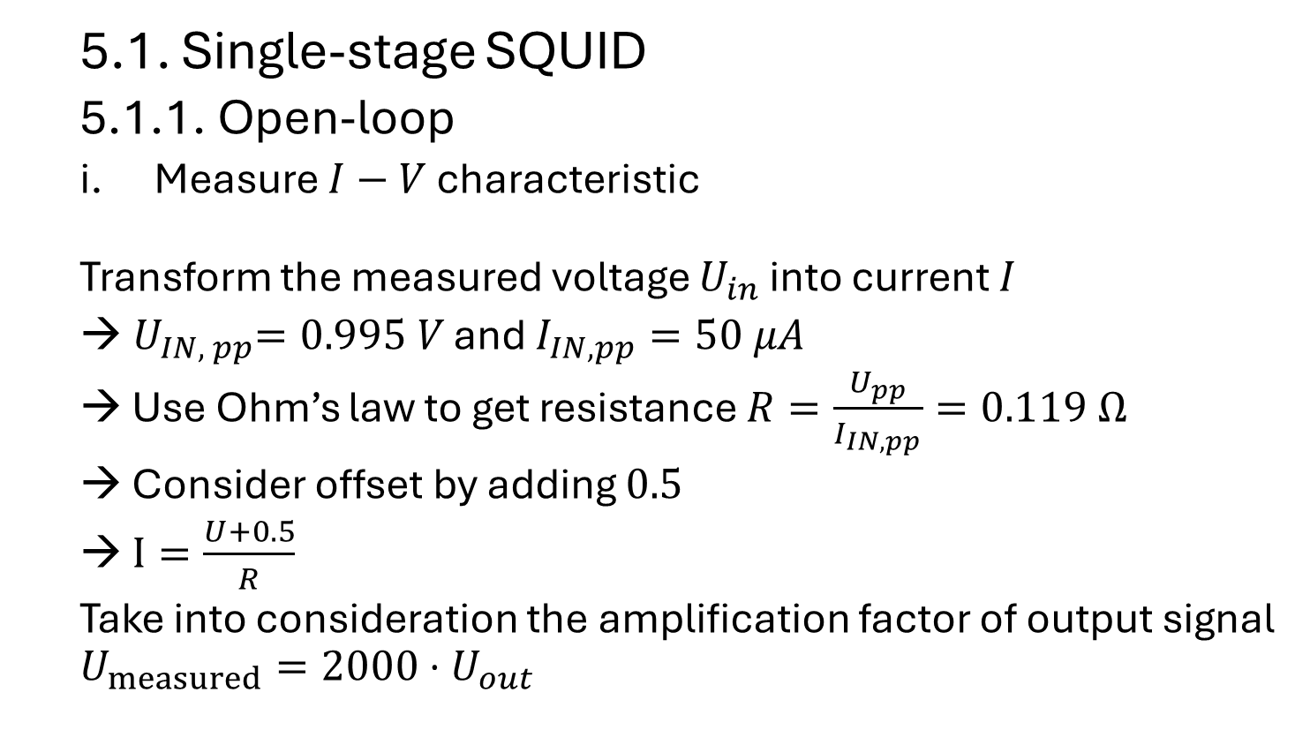
5. Evaluation of measurements
5.1. Single-stage SQUID
5.1.1. Open-loop
Measure $I−V$ characteristic
Transform the measured voltage $U_{in}$ into current $I$
${ U}_{IN, pp}=0.995 V$ and $I_{IN, pp}=50 μA$
Use Ohm’s law to get resistance $R=\frac{U_{pp}}{I_{IN,pp}}=0.119 Ω$
Consider offset by adding $0.5$
$I=\frac{U+0.5}{R}$
Take into consideration the amplification factor of output signal $U_{measured}=2000⋅U_{out}$

Slide 27
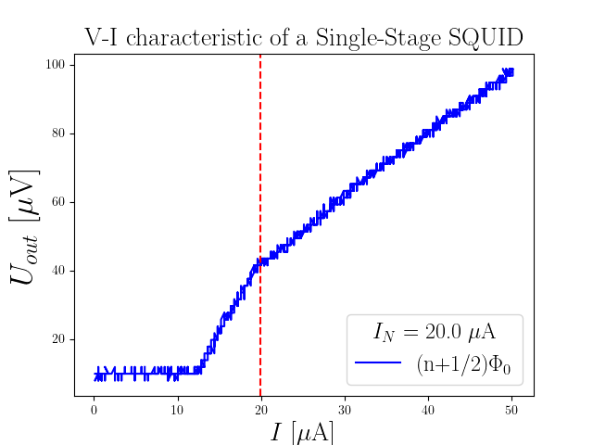
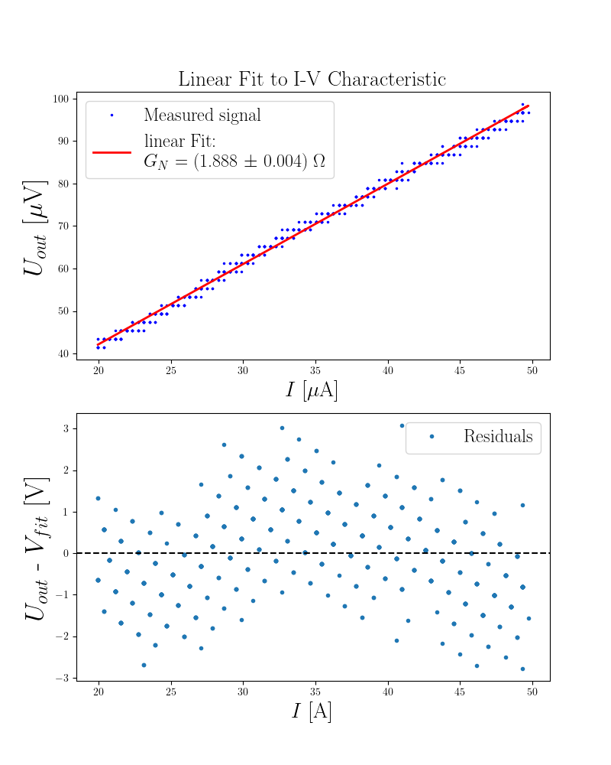
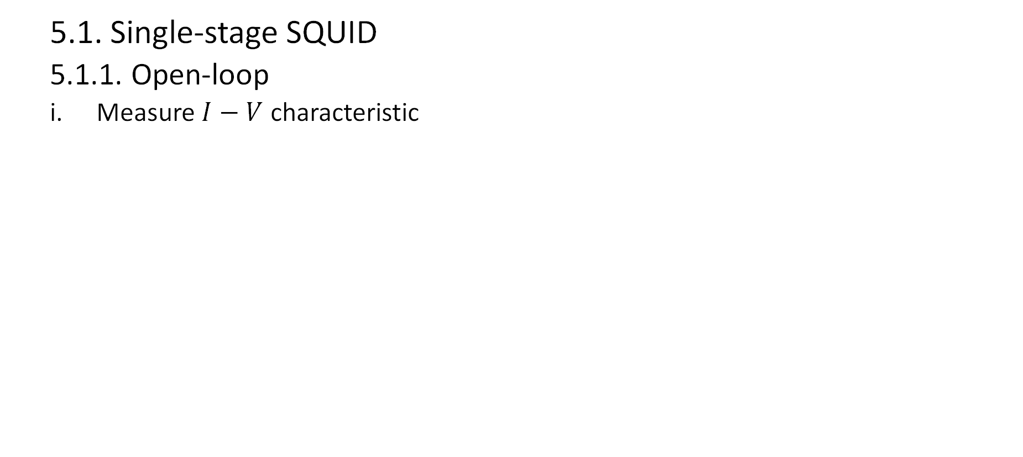
5. Evaluation of measurements
5.1. Single-stage SQUID
5.1.1. Open-loop
Measure $I−V$ characteristic
Fig. 2: $I−V$ characteristic of a single-stage SQUID (right) and linear fit to its linear range (left)

Slide 28
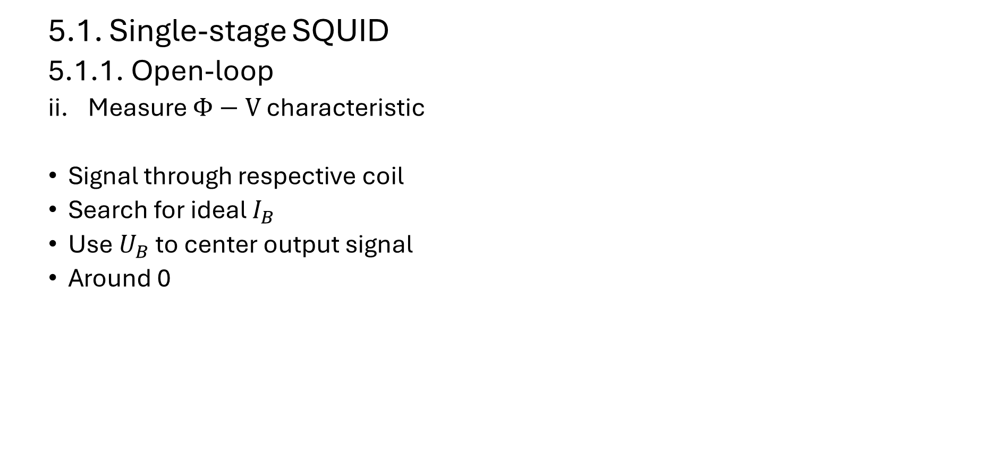
5. Evaluation of measurements
5.1. Single-stage SQUID
5.1.1. Open-loop
ii. Measure $Φ−V$ characteristic
Signal through respective coil
Search for ideal $I_{B}$
Use $U_{B}$ to center output signal
Around 0
bias current
input-signal
bias voltage
Notes:
Set everyting to zero. Only turn on biasing current. AMP mode (open loop) U_out amplified by 2000

Slide 29
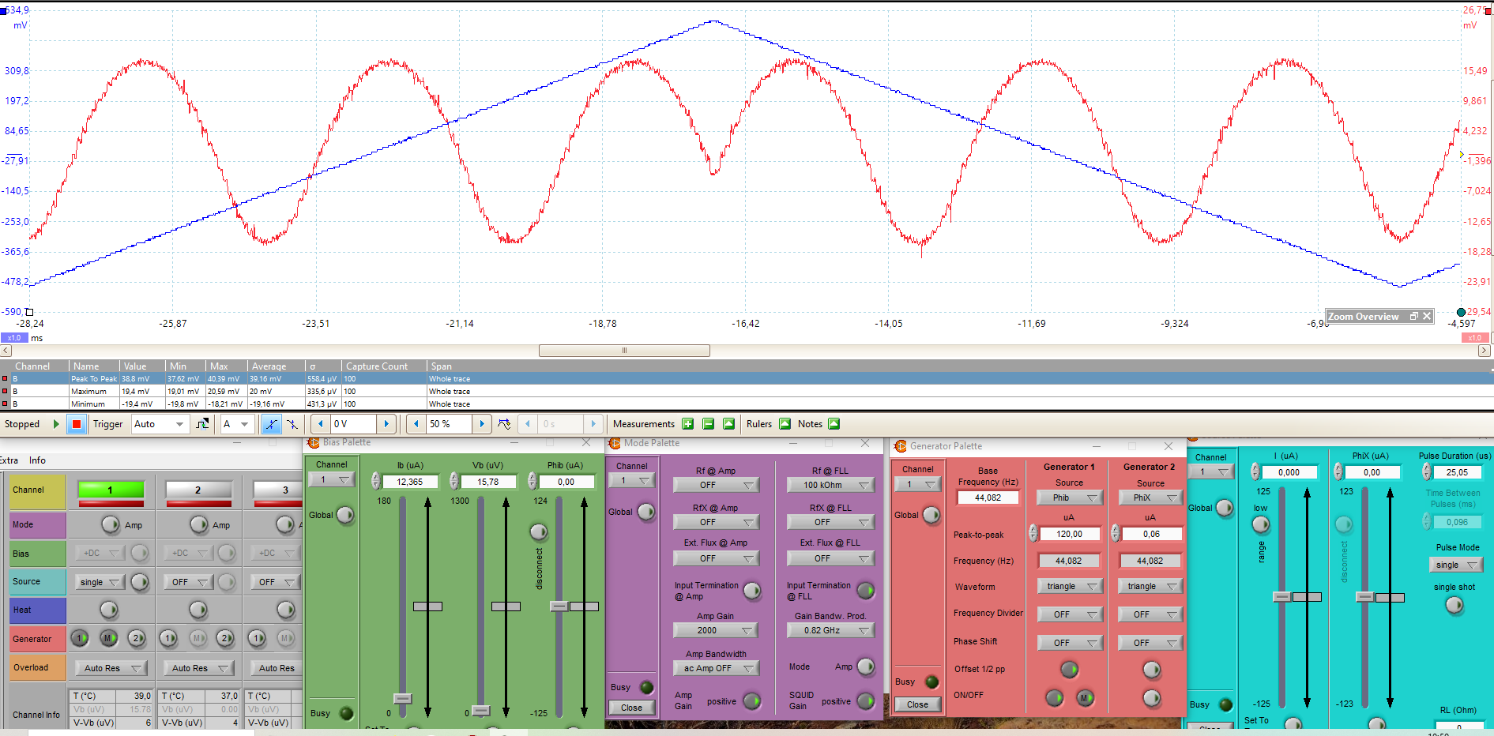
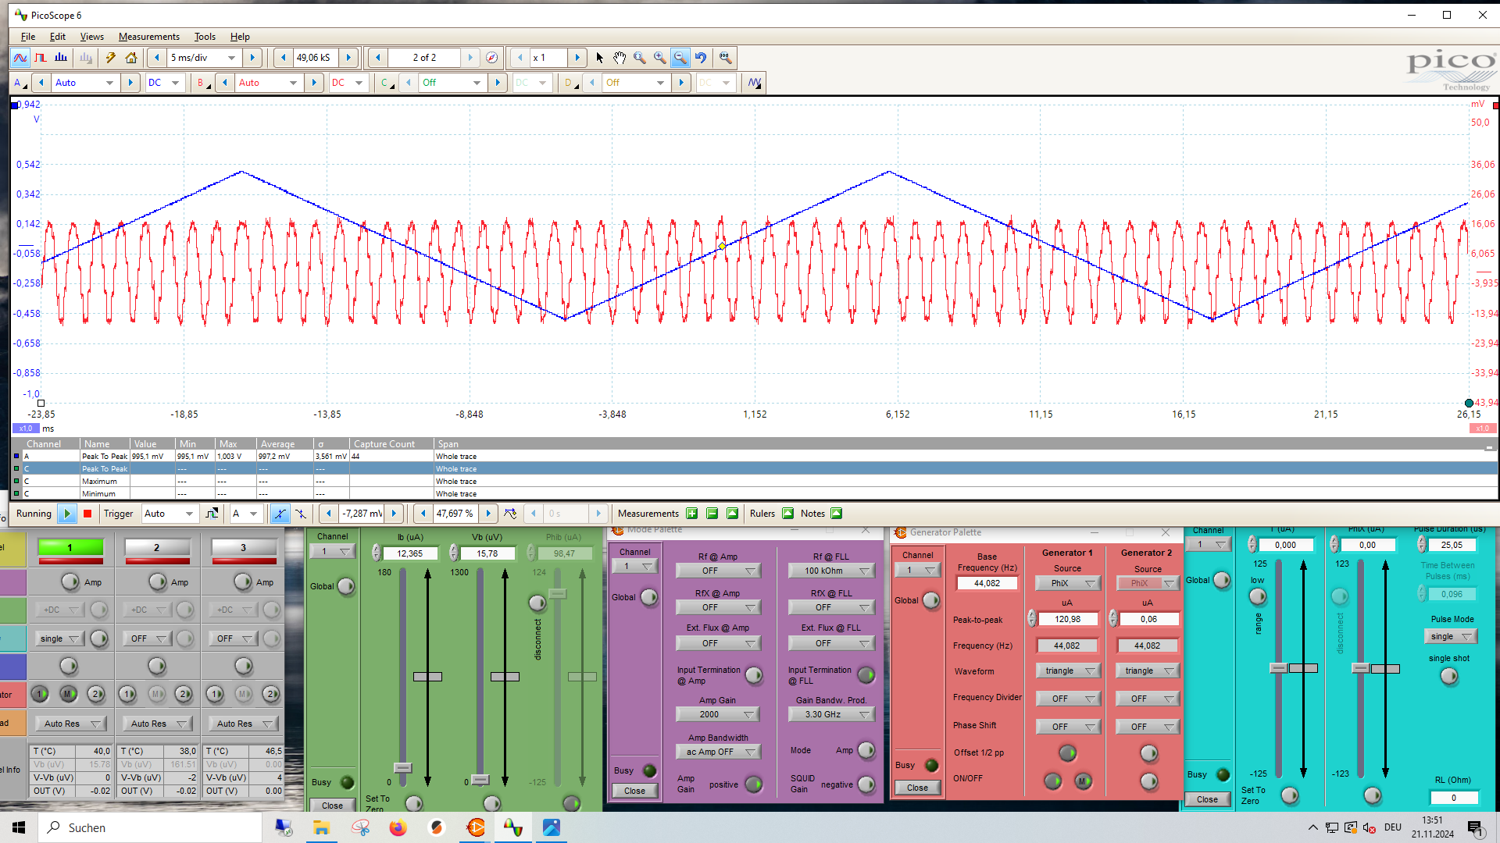
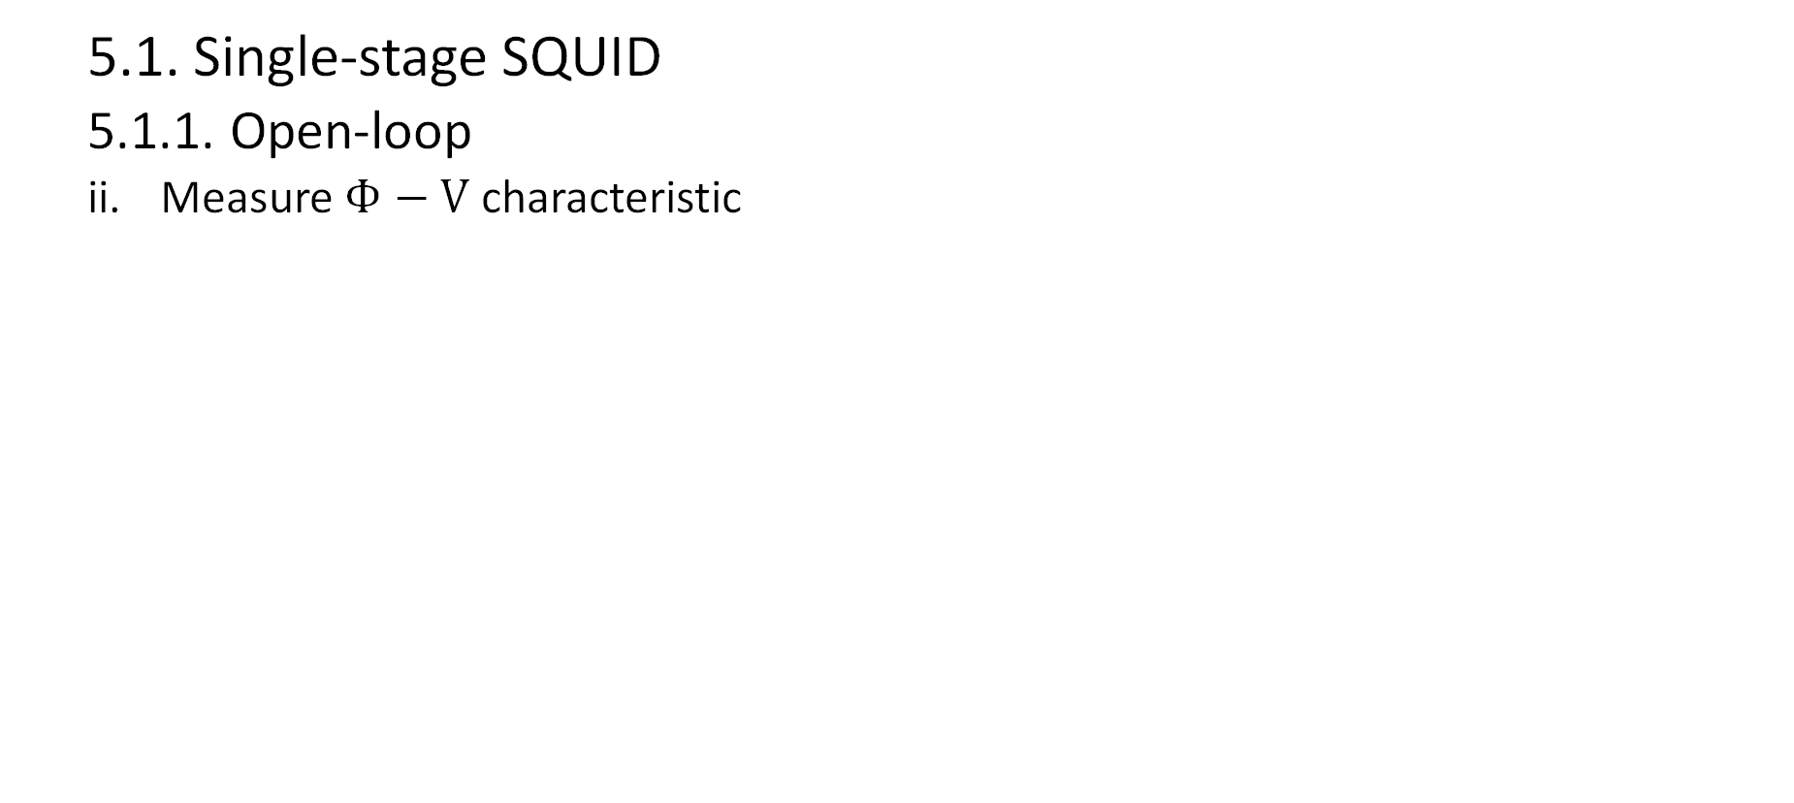
5. Evaluation of measurements
5.1. Single-stage SQUID
5.1.1. Open-loop
ii. Measure $Φ−V$ characteristic
Fig. 3: Measured $U_{in, Φ_{B}}$ and $U_{out,Φ_{B}}$ (left), and $U_{in, Φ_{X}}$ and $U_{out,Φ_{X}}$ (right) of a single-stage SQUID. Optimal parameters: $I_{B}=12,365μ$A and $U_{B}=50μ$A
Notes:
Turn on function input-signal in repective coil. Bias current I_B: maximal U_out swing. U_B center U_out around zero
Problem: multiple values with same voltage swing

Slide 30
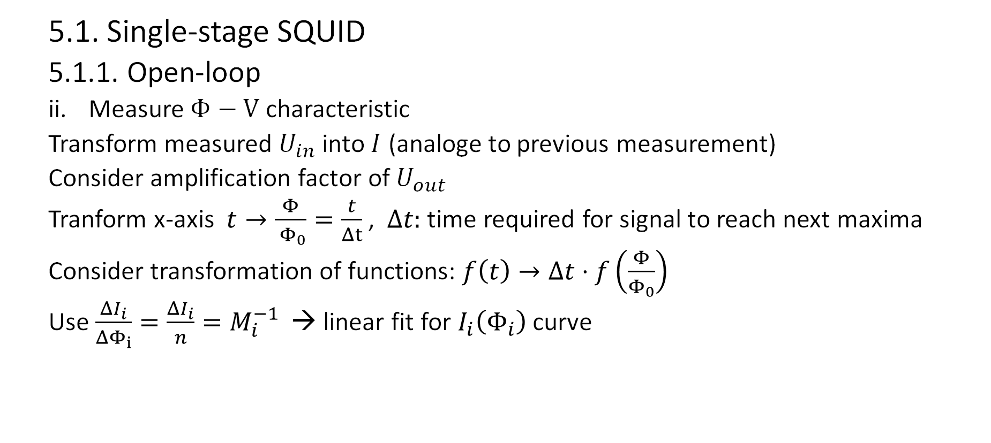
5. Evaluation of measurements
5.1. Single-stage SQUID
5.1.1. Open-loop
ii. Measure $Φ−V$ characteristic
Transform measured $U_{in}$ into $I$ (analoge to previous measurement)
Consider amplification factor of $U_{out}$
Tranform x-axis $t→\frac{Φ}{ Φ_{0}}=\frac{t}{Δt}$, $Δt:$ time required for signal to reach next maxima
Consider transformation of functions: $f\left(t\right)→Δt⋅f\left(\frac{Φ}{Φ_{0}}\right)$
Use $\frac{ΔI_{i}}{ΔΦ_{i}}=\frac{ΔI_{i}}{n}=M_{i}^{−1}$ → linear fit for $I_{i}\left(Φ_{i}\right)$curve

Slide 31
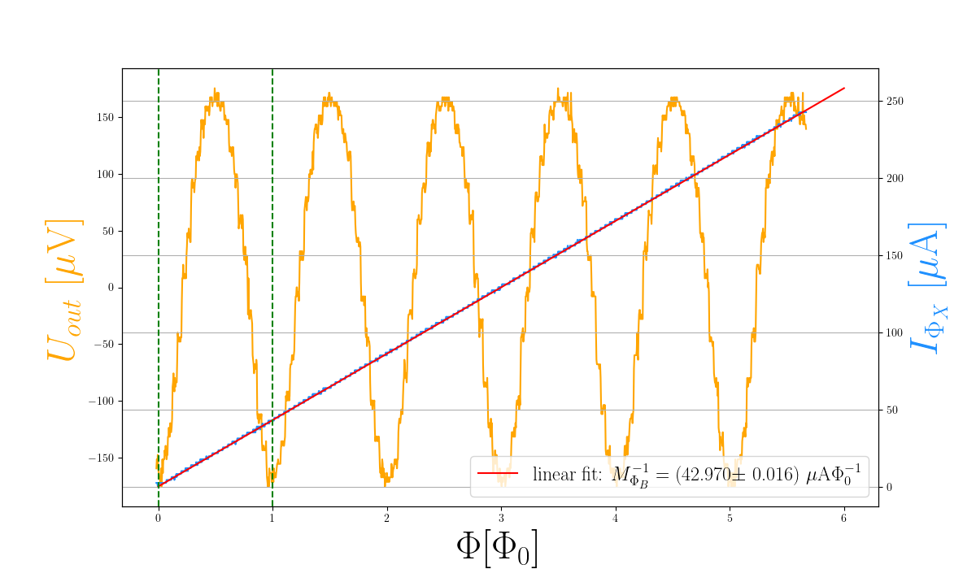
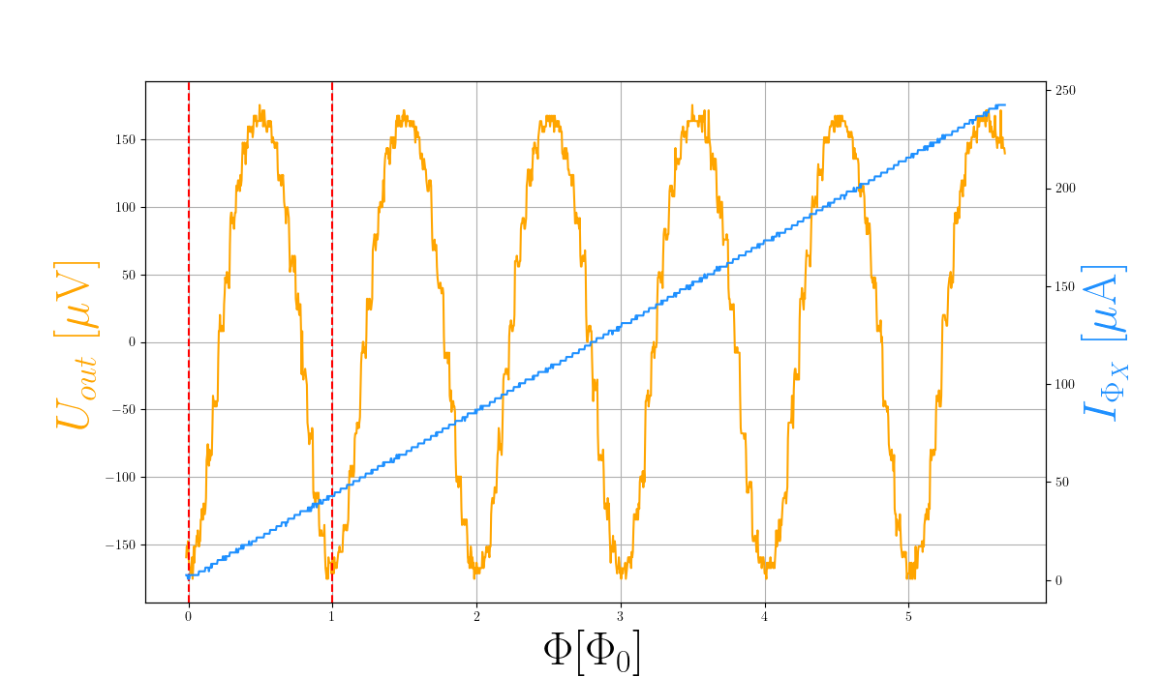
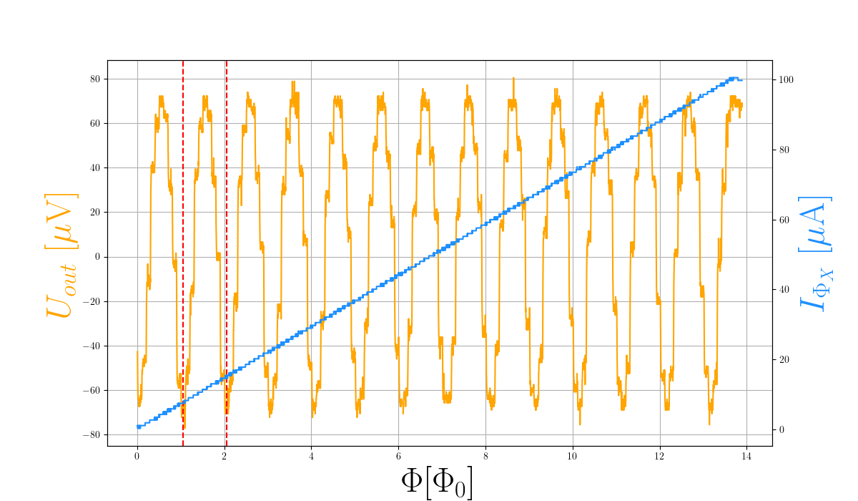
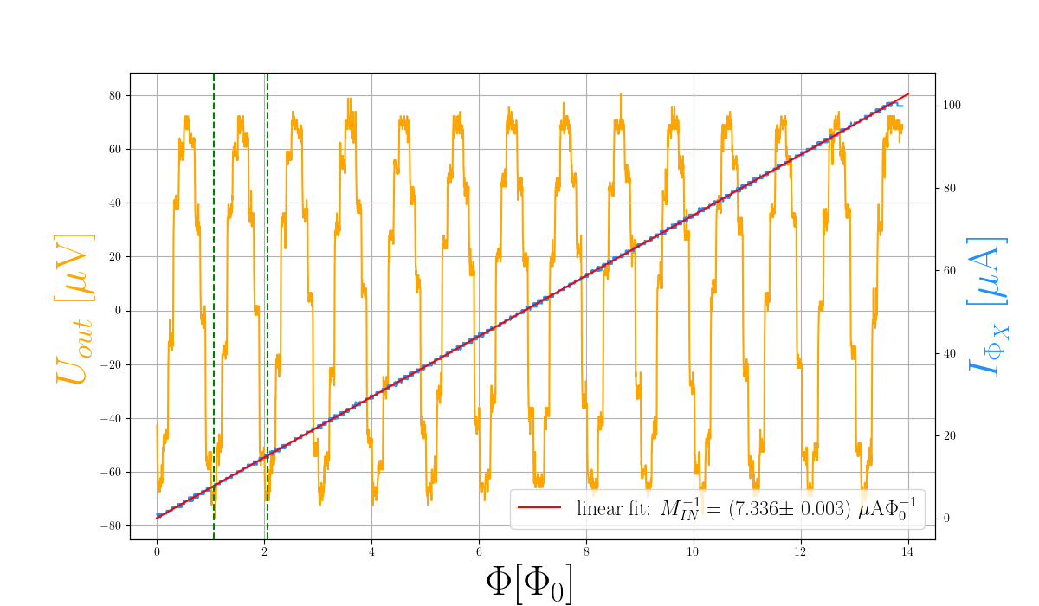
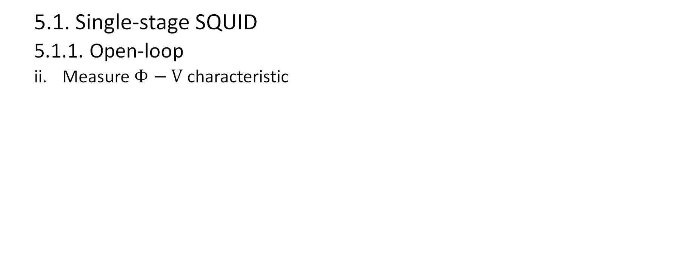
5. Evaluation of measurements
5.1. Single-stage SQUID
5.1.1. Open-loop
ii. Measure $Φ−V$ characteristic
Fig. 5: $Φ_{B}−V$ (left) and $Φ_{X}−V$ (right) characteristic with linear fit to $I\left(\frac{Φ}{Φ_{0}}\right)$
Fig. 4: $Φ_{B}−V$ (left) and $Φ_{X}−V$ (right) characteristic

Slide 32
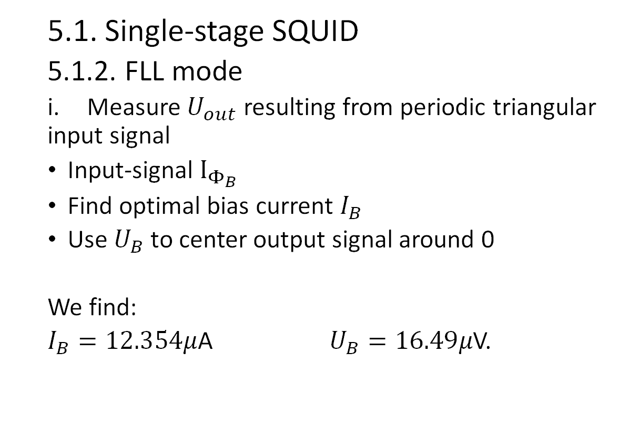
5. Evaluation of measurements
5.1. Single-stage SQUID
5.1.2. FLL mode
i. Measure $U_{out}$ resulting from periodic triangular input signal
Input-signal $I_{Φ_{B}}$
Find optimal bias current $I_{B}$
Use $U_{B}$ to center output signal around 0
We find:
$I_{B}=12.354μ$A $U_{B}=16.49μ$V.
bias current
bias voltage
input-signal
Notes:
Generator in I_\Phi_B, M_\Phi_B is M_IN. I_B maximal voltage swing. Turn off genetarot I_Phi_B to move U_out to zero. Singal to Phi_X move U_out to zero.

Slide 33
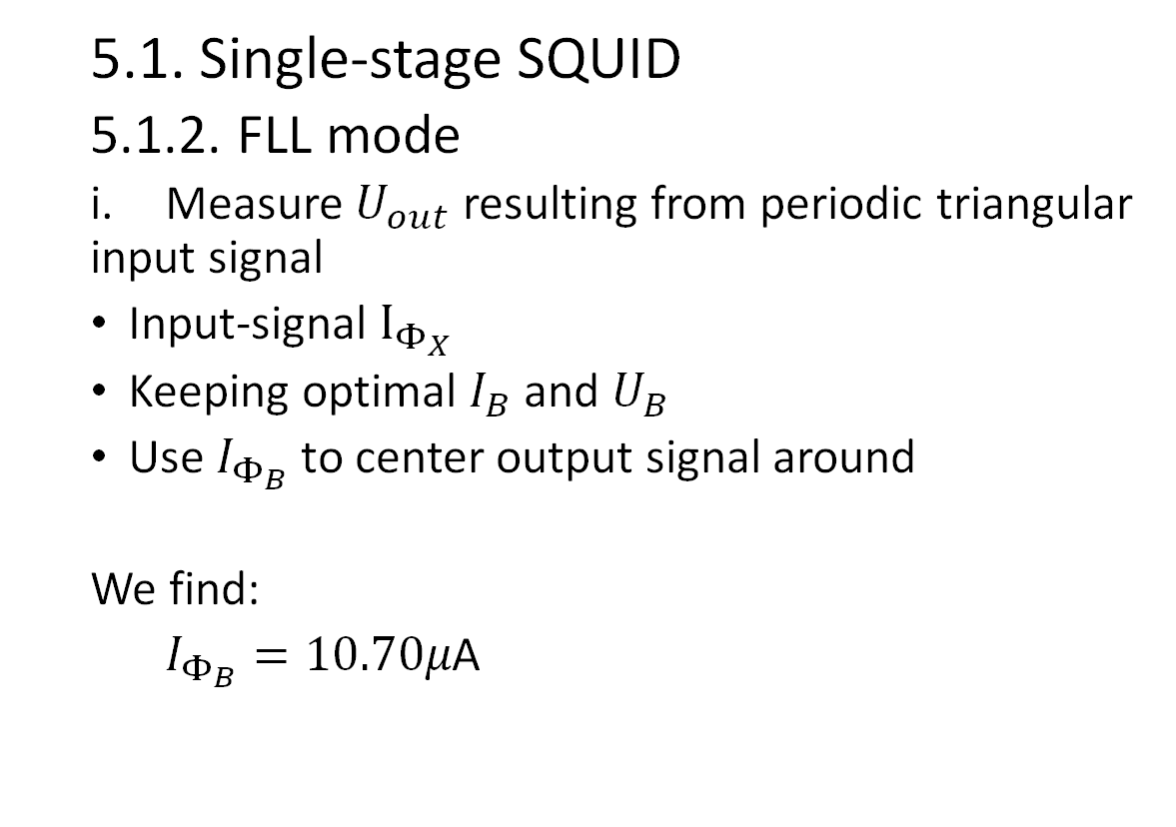
5. Evaluation of measurements
5.1. Single-stage SQUID
5.1.2. FLL mode
i. Measure $U_{out}$ resulting from periodic triangular input signal
Input-signal $I_{Φ_{X}}$
Keeping optimal $I_{B}$ and $U_{B}$
Use $I_{Φ_{B}}$ to center output signal around
We find:
$I_{Φ_{B}}=10.70μ\text{A}$
input-signal
bias current
Notes:
Generator in I_\Phi_B, M_\Phi_B is M_IN. I_B maximal voltage swing. Turn off genetarot I_Phi_B to move U_out to zero. Singal to Phi_X move U_out to zero.

Slide 34
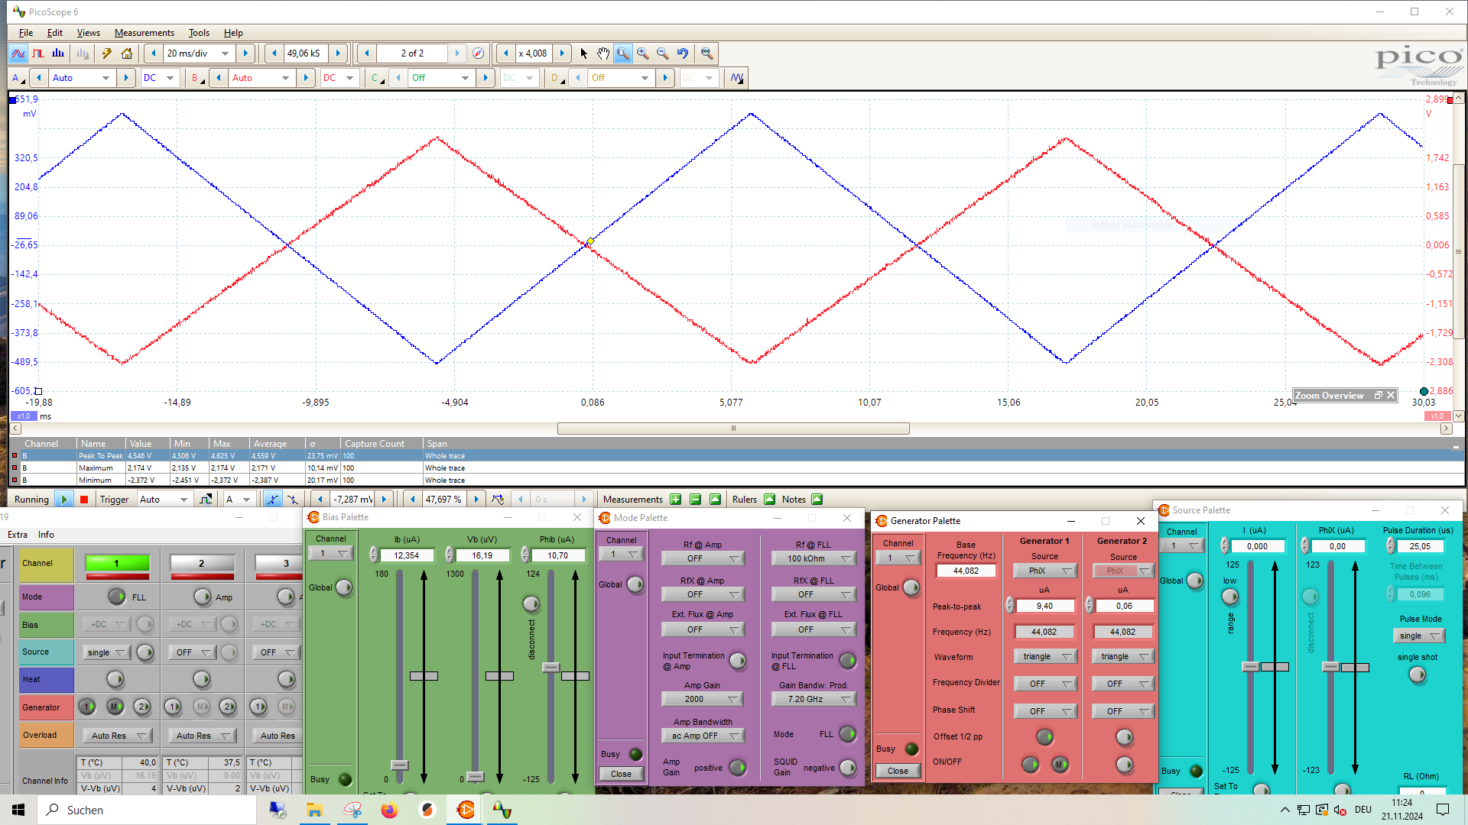

5. Evaluation of measurements
5.1. Single-stage SQUID
5.1.2. FLL mode
i. Measure $U_{out}$ resulting from periodic triangular input signal
Fig. 5: Measured $U_{in}$ and $U_{out}$ of a single-stage SQUID in FLL mode. Workingpoint:
Notes:
Generator in I_\Phi_B, M_\Phi_B is M_IN. I_B maximal voltage swing. Turn off genetarot I_Phi_B to move U_out to zero. Singal to Phi_X move U_out to zero.

Slide 35

5. Evaluation of measurements
5.1. Single-stage SQUID
5.1.2. FLL mode
i. Measure $U_{out}$ resulting from periodic triangular input signal
Transform $U_{in}$ into $I_{in}$
Fit linear function to ${−U}_{out}\left(I_{in}\right)$ curve

Slide 36



5. Evaluation of measurements
5.1. Single-stage SQUID
5.1.2. FLL mode
i. Measure $U_{out}$ resulting from periodic triangular input signal in FLL mode
Fig. 6: Measured $I_{IN}$ and $U_{out}$ signals (left) and linear fit to the ${−U}_{out}\left(I_{IN}\right)$ curve (right)

Slide 37

5. Evaluation of measurements
5.1. Single-stage SQUID
5.1.2. FLL mode
Measure $U_{out}$ resulting from periodic triangular input signal
Calculate amplification factor using previously calculated variables
→ $m_{exp, 2}=R_{F}\frac{M_{IN}}{M_{Φ_{B}}}$ $Δm_{exp, 2}=m_{exp,2}\sqrt{{\left(\frac{{\left(ΔM_{IN}\right)}_{err}}{ΔM_{IN}}\right)}^{2}+{\left(\frac{{\left(ΔM_{Φ_{B}}\right)}_{err}}{ΔM_{Φ_{B}}}\right)}^{2}}$
We find :
$m_{exp, 2}=\left(0.58574±0.00003\right)$ V$μA^{−1}$
Comparison between both values:
$σ=3.58$

Slide 38

5. Evaluation of measurements
5.1. Single-stage SQUID
5.1.2. FLL mode
ii. Measure noise spectrum
Validity range: GBP where
no resonances are formed.
→ GBP must be smaller than
16GHz
Fig. 7: Measured noise spectrum in FLL mode at GBP = 3.3 GHz with workingpoint parameters

Slide 39

5. Evaluation of measurements
5.2. Temperature measurement
i. Measure $Φ−V$ characteristic in open-loop mode
First: Tune SQUID array
as a single-stage SQUID
Input-signal $I_{Φ_{X}}$
Find optimal bias current $I_{B}$
Use $U_{B}$ to center output signal around
We find:
$I_{B}=9,705μ$A $U_{B}=161,51μ$V
bias current
input-signal
Bias voltage
Notes:
First Tunne array like 1-s. SQUID. Signal I_Phi_X find I_B. Center U_out around 0 with U_B. While array is optimal. Turn on signal I_\Phi_B find bias of frontend SQUID I . Center with I_\Phi_X

Slide 40

5. Evaluation of measurements
5.2. Temperature measurement
i. Measure $Φ−V$ characteristic in open-loop mode
Second: Tune frontend SQUID
Keep optimal values of second-stage
SQUID
Input-signal $I_{Φ_{B}}$
Find optimal bias current $I$
Use $I_{Φ_{X}}$ to center output signal
around
We find:
$I=15.720μ$A $I_{Φ_{X}}=25.44μ$A
bias current
bias current
input-signal
Notes:
First Tunne array like 1-s. SQUID. Signal I_Phi_X find I_B. Center U_out around 0 with U_B. While array is optimal. Turn on signal I_\Phi_B find bias of frontend SQUID I . Center with I_\Phi_X

Slide 41


5. Evaluation of measurements
5.2. Temperature measurement
i. Measure $Φ−V$ characteristic in open-loop mode
Fig. 8: $Φ_{B}−V$ characteristic at optimal working point $Q$($I_{B}$, $I_{Φ_{B}}$, $I_{Φ_{X}}$, $U_{B})$
Notes:
First Tunne array like 1-s. SQUID. Signal I_Phi_X find I_B. Center U_out around 0 with U_B. While array is optimal. Turn on signal I_\Phi_B find bias of frontend SQUID I . Center with I_\Phi_X

Slide 42

5. Evaluation of measurements
5.2. Temperature measurement
ii. Measure noise spectrum in FLL mode
Turn off function generator
Keep previously found optimal
parameters
Use $I_{Φ_{B}}$ to center signal around zero
We find:
$I_{Φ_{B}}=9.67μ$A
Stable working point for temperature
measurement
Bias-current
Notes:
First Tunne array like 1-s. SQUID. Signal I_Phi_X find I_B. Center U_out around 0 with U_B. While array is optimal. Turn on signal I_\Phi_B find bias of frontend SQUID I . Center with I_\Phi_X

Slide 43

5. Evaluation of measurements
5.2. Temperature measurement
ii. Measure noise spectrum in FLL mode
Fig. 9: Measured noise spectrum in FLL mode at optimal working point.
Notes:
Turn off all input signals and

Slide 44

5. Evaluation of measurements
5.2. Temperature measurement
ii. Measure noise spectrum in FLL mode
Transform measured spectrum into voltage spectral density
→ $\sqrt{S_{V}}=\frac{1}{Δf} {10}^{U/20}$
Transform voltage spectral density into current spectral density
→ $\sqrt{S_{I}}=m^{−1}⋅\sqrt{S_{V}}$
Fit expected current spectral density to measured $T$ and $R$
→ $S_{I}=\frac{4k_{B}T}{R}\frac{1}{1+f^{2}/f_{c}^{2}}$

Slide 45

5. Evaluation of measurements
5.2. Temperature measurement
ii. Measure noise spectrum in FLL mode
Fig. 10: Measured current density function $\sqrt{S_{I}}$ (blue line) and fitted model (green line)
Notes:
Mention what motivates the fitting-range

Slide 46
6. Discussion & Comments

Slide 47

6. Discussion & Comments
6.2. Discussion
Single-stage SQUID’s characteristics consistent with flux-quantization
Linearization of signal in FLL mode
Measured $T_{He}$ consistent with literature

Slide 48

6. Discussion & Comments
6.2. Discussion
(Small) fit parameters’ errors are not representative
→ Use more than one period of input signal for parameter estimation
$Φ_{B}−V$ off. Expected $M_{IN}^{−1}∼9μ$A$Φ_{0}^{−1}$
→Inadecuate tuning: voltage drop constant for an interval of applied current
Significant deviation between $m_{exp,1}$ and $m_{exp,2}$
→ Missing statistical and systematic errors
→ Problems from $M_{IN}^{−1}$ estimation
Tuning of double-stage SQUID is not ideal
→Fine tuning
A larger fit range of $S_{I}$ could improve the precision of $T_{He}$

Slide 49
5. Discussion & Comments
6.3. Comments
Pros:
Done in one evening
Easy operation
Cons:
PEPV not indispensable, but helps with understanding
Electronics can feel abstract
Lab’s script not ideal
Nomenclature
Evaluation
Recommendation:
Careful reading of tasks

